Slide 1


CREDIT CARD FRAUD DETECTION
190330055 – D SHILPA REDDY
190330109 – K SHIVANI
190330304 – K PADMINI
190330161 – N SUPRAJA

Slide 2

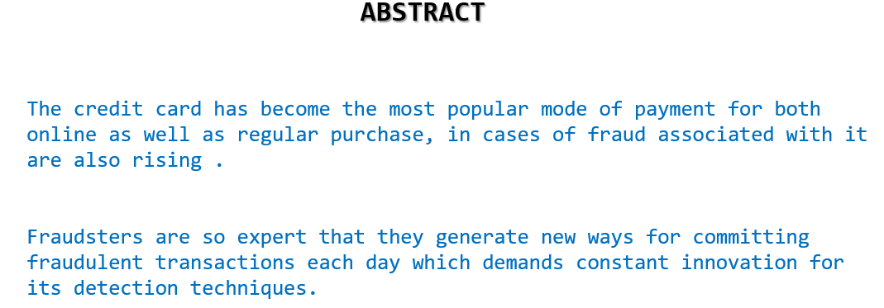
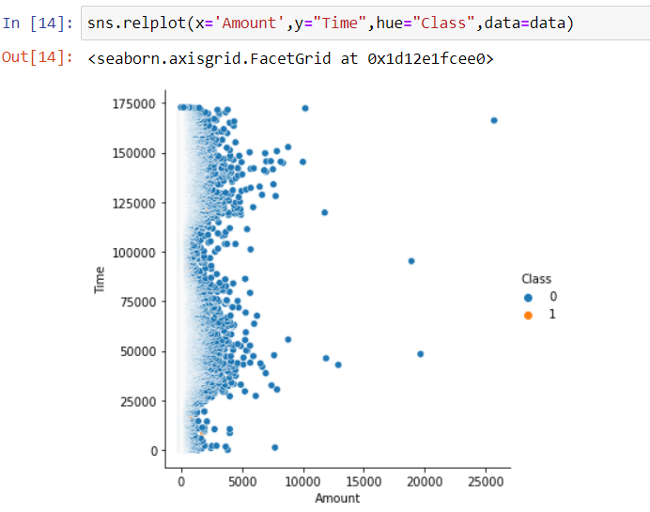
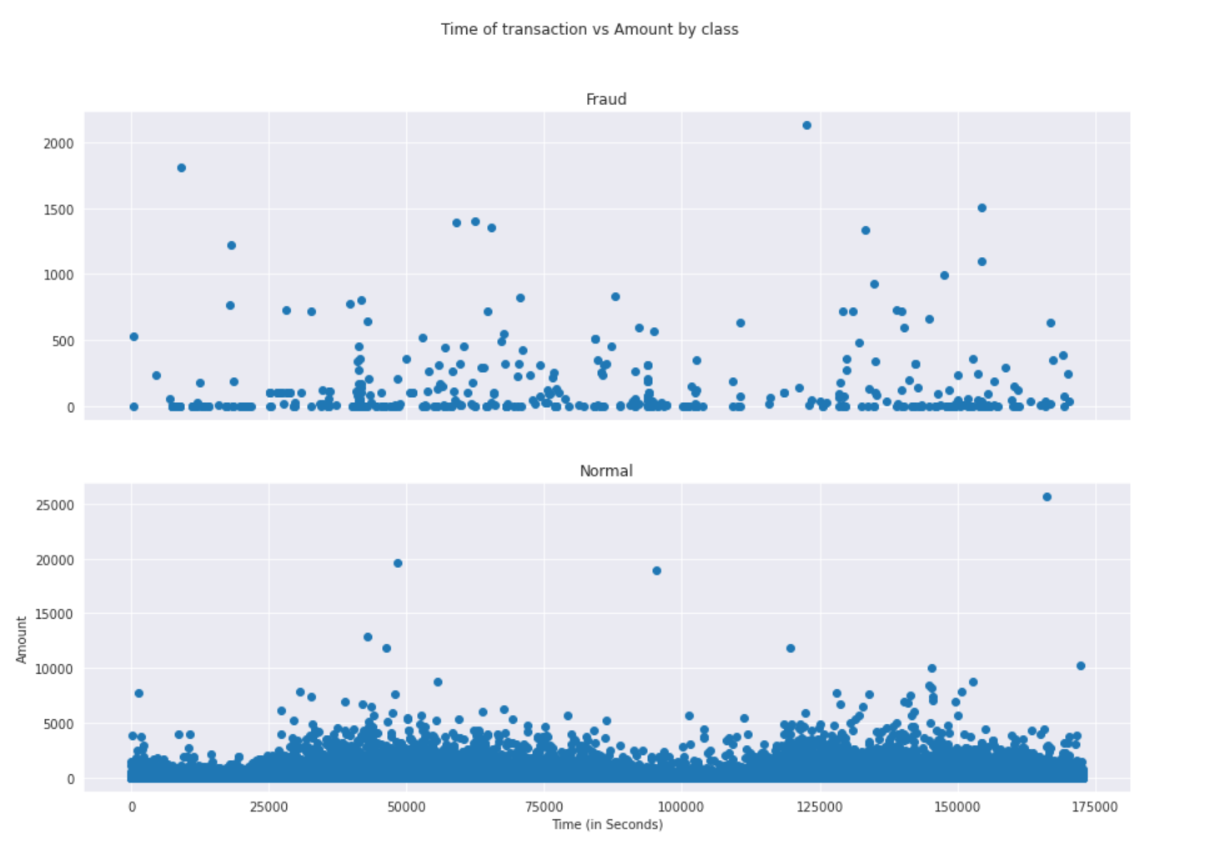
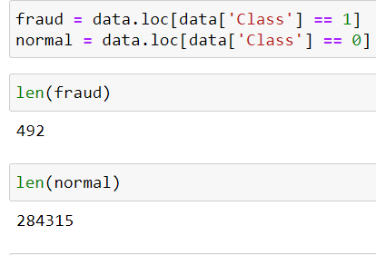
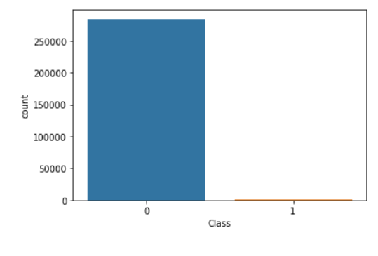
CREDIT CARD FRAUD DETECTION

Slide 3
ABSTRACT
The credit card has become the most popular mode of payment for both online as well as regular purchase, in cases of fraud associated with it are also rising .
Fraudsters are so expert that they generate new ways for committing fraudulent transactions each day which demands constant innovation for its detection techniques.
KEYWORDS:
Artificial Intelligence, Machine Learning, Logistic Regression, Random Forest, Credit Card Fraud Detection.

Slide 4
INTRODUCTION
Fraud detection is a set of activities that are taken to prevent money or property from being obtained through false pretenses .
The majority of detection methods combine a variety of fraud detection datasets to form a overview of both valid and non-valid payment data to make a decision.
Some of the popular methods used by fraudster to preptrate internet credit card fraud include:
→Site duplication
→Manufacturing of illegal credit cards

Slide 5
Literature Survey
Fraud Detection Process
Credit card fraud detection is the process of knowing whether or not a set of credit card transactions is in the category of fraudulent or legitimate instances of buying or selling something (Maeset al., 2002).
Some desirable characteristics of a Fraud Detection System (FDS) include efficient detection of fraud, and high effectiveness or productivity in relation to its cost in transaction checking (Quah and Sriganesh, 2008).

Slide 6
Existing System
Since the credit card fraud detection system is a highly researched field, there are many different algorithms and techniques for performing the credit card fraud detection system. One of the earliest system is CCFD system using markov model.
Some other various existing algorithms used in the credit cards fraud detection system includes Cost sensitive decision tree (CSDT), support vector machine (SVM), Random forest, etc.
credit card fraud detection(CCFD) is also proposed by using neural networks

Slide 7
Proposed system
Random Forest Algorithm(RFA) is used for finding the fraudulent transactions and the accuracy of those transactions.
This algorithm is based on supervised learning algorithm where it uses decision trees for classification of the dataset.
After classification of dataset a confusion matrix is obtained

Slide 8
PROBLEM STATEMENT
With the growth of e-commerce websites, people rely on online services to carry out their transactions that led to an increase in the credit card frauds.
For many companies, fraud detection is a big problem because they find these fraudulent activities after they experience high loss.
In the current generation, with high-end technology, still, on every 100 credit card transactions, 13% are falling into the fraudulent activities reported by the credit-cards website

Slide 9
Project analysis slide 2
AGENDA
The main objective of the project is to implement Machine learning algorithm to detect credit card fraud detection with respect to time and amount of transaction.
Credit card fraud detection methods need constant innovation.
We evaluate two data mining approaches, random forests, together with the well known logistic regression,to better credit card fraud.

Slide 10
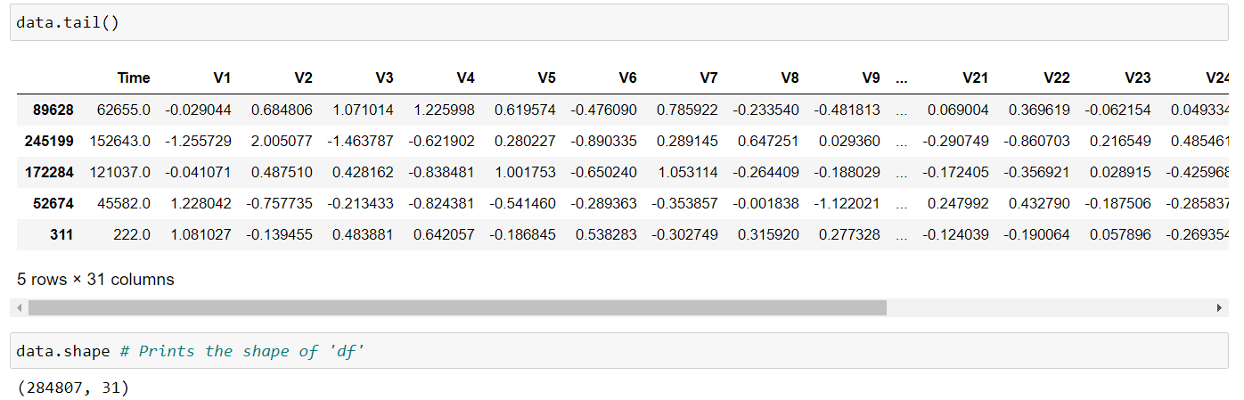
DATASET
The dataset “credit-card” was taken
from kaggel.com
The dataset is quite unbalanced and positive class account only for few transactions and most of them are abnormal
transactions.so we have to identify those fraudulent activities
Feature class is the response variable and it takes value 1 in case of fraud and 0 otherwise

Slide 11
ALGORITHM AND
IMPLEMENTATION
Random Forest Algorithm(RFA)
used for finding the fraudulent transactions and the accuracy of those transactions.
This algorithm is based on supervised learning algorithm where it uses decision trees for classification of the dataset. After classification of dataset a confusion matrix is obtained.
The performance of Random Forest Algorithm is evaluated based on the confusion matrix. The results obtained from processing the dataset gives accuracy of about 90%.
Logistic regression
Logistic regression is one of the most popular machine learning algorithms that is used for classification.
In logistic regression, the prediction is expressed in terms of probability of outcome belonging to each class.

Slide 12
VISUALIZATION

Slide 13
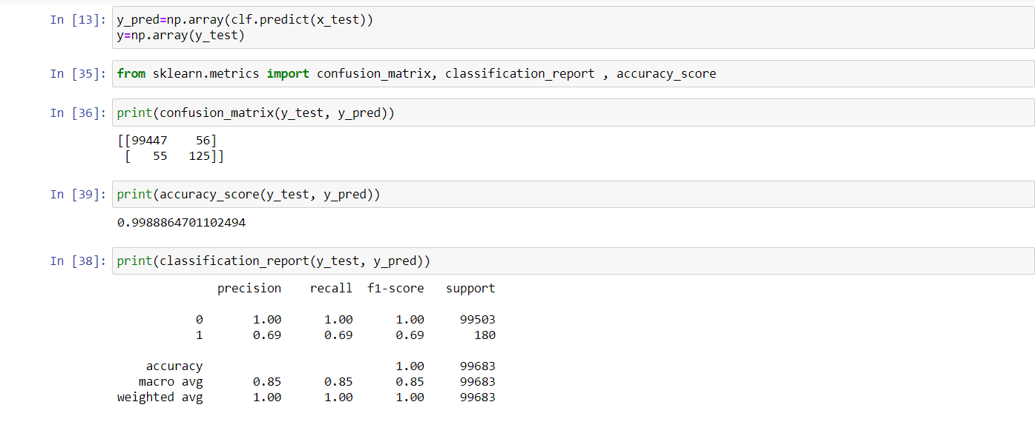
RESULT ANALYSYIS
The code prints out the number of false positives it detected and compares it with the actual values. This is used to calculate the accuracy score and precision of the algorithms.
The fraction of data we used for faster testing is 10% of the entire dataset. The complete dataset is also used at the end and both the results are printed. These results along with the classification report for each algorithm is given in the output as follows, where class 0 means the transaction was determined to be valid and 1 means it was determined as a fraud transaction.

Slide 14
CONCLUSION
In this proposed scheme, we applied machine learning techniques to predict whether a credit card transaction is fraudulent or not.
The datasets contains transactions made by credit cards in September 2013 by European cardholders. This dataset presents transactions that occurred in two days, where we have 492 frauds out of 284,807 transactions. The dataset is highly unbalanced, the positive class (frauds) account for 0.172% of all transactions.
As a result, it tends to misrepresent a fraudulent transaction as a genuine transaction. To tackle this problem, we implemented a data level approach which includes Logistic Regression.

Slide 15
References
Ghosh, S., and Reilly, D.L., 1994. Credit Card Fraud Detection with a Neural Network, 27th Hawaii International l Conference on Information Systems, vol. 3 (2003), pp. 621- 630
https://www.creditcards.com/credit-card-news/assets/HowACreditCardIsProcessed.pdf
https://www.kaggle.com/dalpozz/creditcardfraud

Slide 16
Thank You

